Slide 1
Chap 5: Genetic Algo.
BCS2313: Artificial Intelligence Techniques

Slide 2
Genetic Algorithms
In the early 1970s, John Holland introduced the concept of genetic algorithms.
His aim was to make computers do what nature does. Holland was concerned with algorithms that manipulate strings of binary digits.
Each artificial “chromosomes” consists of a number of “genes”, and each gene can be represented by 0, 1, A, a, B, Z, 9, 3 etc.

Slide 3
Genetic Algorithm Steps
Step 1:
Represent the problem variable domain as a chromosome of a fixed length, choose the size of a chromosome population N, the crossover probability p_{c} and the mutation probability p_{m} .
Step 2:
Define a fitness function to measure the performance, or fitness, of an individual chromosome in the problem domain. The fitness function establishes the basis for selecting chromosomes that will be mated during reproduction.

Slide 4
Genetic Algorithm Steps
Step 3:
Randomly generate an initial population of chromosomes of size N:
x₁; x₂; . . . ; x_{N}
Step 4:
Calculate the fitness of each individual chromosome:
f(x₁) , f(x₂) , . . . , f(x_{N})

Slide 5
Genetic Algorithm Steps
Step 5:
Select a pair of chromosomes for mating from the current population. Parent chromosomes are selected with a probability related to their fitness. Highly fit chromosomes have a higher probability of being selected for mating than less fit chromosomes.
Step 6:
Create a pair of offspring chromosomes by applying the genetic operators – crossover and mutation.

Slide 6
Genetic Algorithm Steps
Step 7:
Place the created offspring chromosomes in the new population.
Step 8:
Repeat Step 5 until the size of the new chromosome population becomes equal to the size of the initial population, N.

Slide 7
Genetic Algorithm Steps
Step 9:
Replace the initial (parent) chromosome population with the new (offspring) population.
Step 10:
Go to Step 4, and repeat the process until the termination criterion is satisfied.

Slide 8
The GA Cycle of Reproduction
children
Selection
modification
modified
children
parents
population
evaluation
evaluated children
deleted
members
discard

Slide 9
Initial Population

Slide 10
Population
Chromosomes could be:
Bit strings (0101 ... 1100)
Real numbers (43.2 -33.1 ... 0.0 89.2)
Permutations of element (E11 E3 E7 ... E1 E15)
Lists of rules (R1 R2 R3 ... R22 R23)
Program elements (genetic programming)
... any data structure ...
population

Slide 11
Parents Selection

Slide 12
Reproduction
children
selection
parents
population
Parents are selected at random with selection chances biased in relation to chromosome evaluations.

Slide 13
Evaluation
The evaluator decodes a chromosome and assigns it a fitness measure
modified
children
evaluated
children
evaluation

Slide 14
Fitness Function

Slide 15
Fitness Function
The fitness function basically determines which possible solutions get passed on to multiply and mutate into the next generation of solutions.
Usually done by analyzing the "genes," which hold some data about a particular solution to the problem you are trying to solve.
The fitness function will look at the genes and make some qualitative assessment, returning a fitness value for that solution.

Slide 16
Fitness Function
The rest of the genetic algorithm will discard any solutions with a "poor" fitness value and accept any with a "good" fitness value.
In short: the goal of a fitness function is to provide a meaningful, measurable, and comparable value given a set of genes.

Slide 17
Parent/Survivor Selection
Strategies
Always keep the best one
Delete the worse
Selection of the parents of the next generation of candidate solutions.
Selection methods : Roulette wheel & Tournament.

Slide 18
Parent/Survivor Selection
Too strong fitness selection bias can lead to sub-optimal solution
Too little fitness bias selection results in unfocused and meandering search

Slide 19
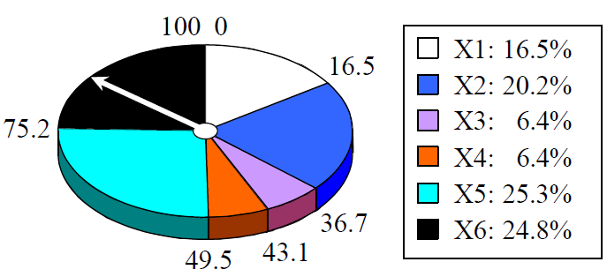
Roulette wheel
Add up the fitness's of all chromosomes
Generate a random number R in that range
Select the first chromosome in the population that - when all previous fitness’s are added - gives you at least the value R

Slide 20
Tournament
Binary tournament
Two individuals are randomly chosen; the fitter of the two is selected as a parent
Probabilistic binary tournament
In this variant, two individuals are chosen at random and the better of the two individuals is selected with fixed probability p, 0.5<p<1
Larger tournaments
n individuals are randomly chosen; the fittest one is selected as a parent
By changing n and/or p, the GA can be adjusted dynamically

Slide 21
Reproduction
Reproduction operators
Crossover
Mutation

Slide 22
Chromosome Modification
Modifications are stochastically triggered
Operator types are:
Mutation
Crossover (recombination)
children
modification
modified children

Slide 23
Reproduction
Crossover
Two parents produce two offspring
There is a chance that the chromosomes of the two parents are copied unmodified as offspring
There is a chance that the chromosomes of the two parents are randomly recombined (crossover) to form offspring
Generally the chance of crossover is between 0.6 and 1.0
Mutation
There is a chance that a gene of a child is changed randomly
Generally the chance of mutation is low (e.g. 0.001)

Slide 24
Crossover Operator
Generating offspring from two selected parents
Single point crossover
Two point crossover (Multi point crossover)

Slide 25
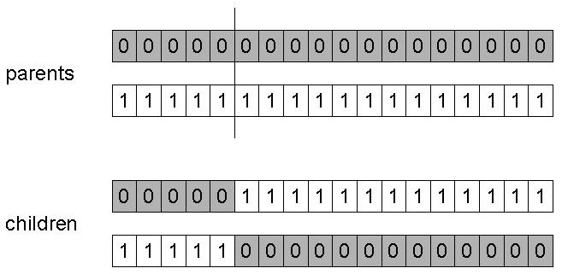
One-Point Crossover
Randomly one position in the chromosomes is chosen
Child 1 is head of chromosome of parent 1 with tail of chromosome of parent 2
Child 2 is head of 2 with tail of 1

Slide 26
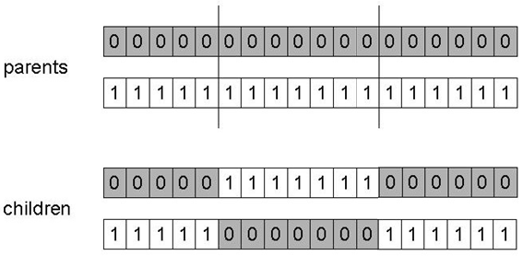
Two-Point Crossover
Randomly two positions in the chromosomes are chosen
Avoids that genes at the head and genes at the tail of a chromosome are always split when recombined

Slide 27
Mutation Operator
Mutation is a genetic operator used to maintain genetic diversity from one generation of a population of algorithm chromosomes to the next.
It is analogous to biological mutation.
Mutation alters one or more gene values in a chromosome from its initial state.

Slide 28
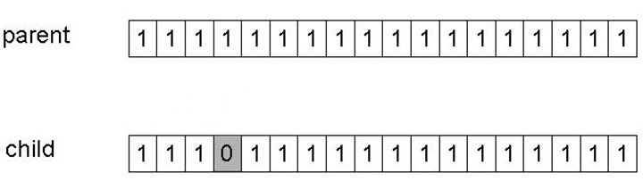
Mutation
Alter each gene independently with a probability pm
pm is called the mutation rate

Slide 29
GA Example

Slide 30
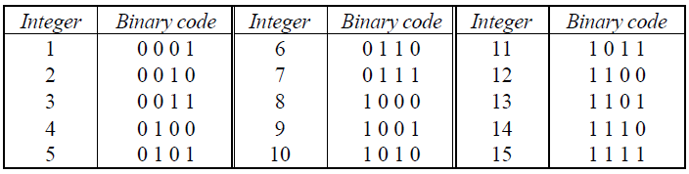
Case Study
Let us find the maximum value of function (15x – x² ) where parameter x varies between 1 to 15. For simplicity, we may assume that x only takes integer value. Thus, table below shows the possible chromosomes that build with only four genes.

Slide 31
Suppose that size of the chromosomes population N is 6, the crossover probability p_{c} equals 0.7, and the mutation probability p_{m} equals 0.001. The fitness function is define by
f(x) = 15x – x²

Slide 32
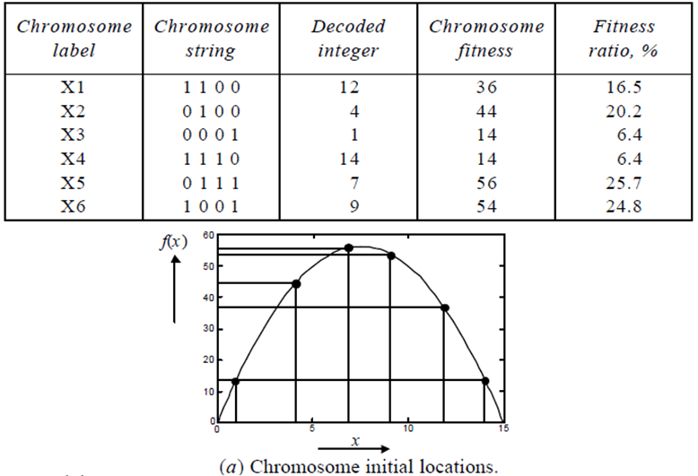
The Fitness Function & Chromosome Location

Slide 33
Selection: Roulette Wheel
Chromosome selection technique: Roulette wheel

Slide 34
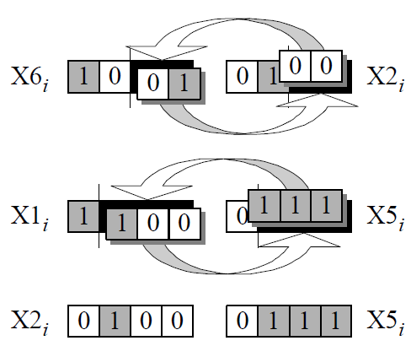
Crossover

Slide 35
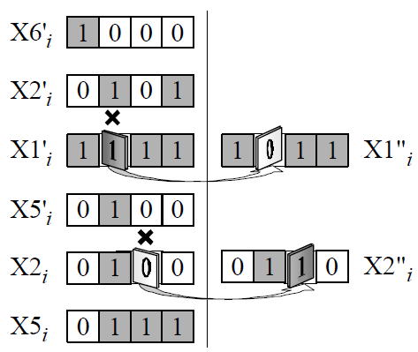
Mutation

Slide 36
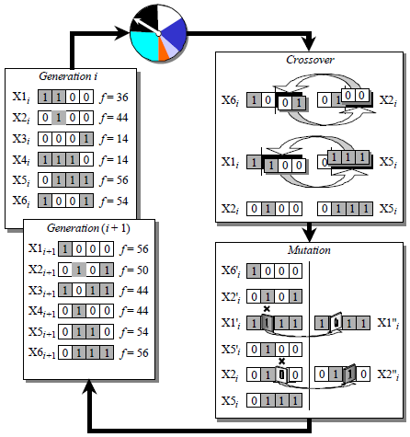
The Genetic Algorithm Cycle

